Slide 1


Systematic Literature Review
Meta-Analysis
KEMTA
Andrea Peeters

Slide 2
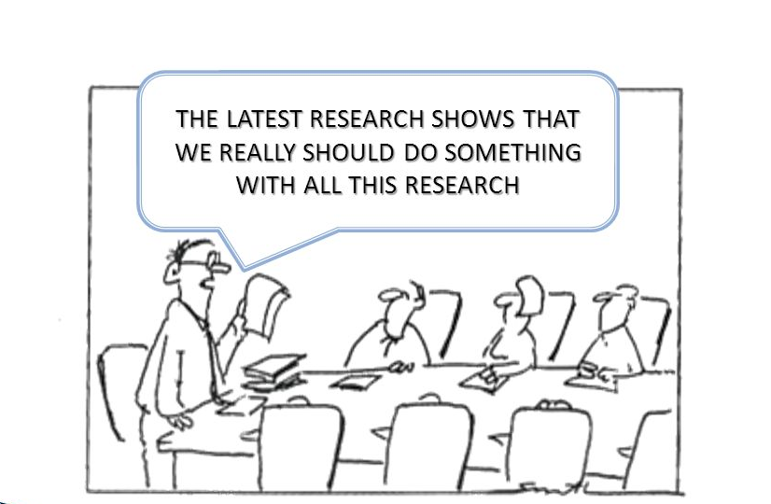
Why do we do it?

Slide 3
Presentation
1. Concepts systematic review and meta-analysis
2. How to design a review
3. How to design a literature search
4. Tools for assessing the quality of the studies
5. Important aspects of meta-analysis

Slide 4

Systematic review
Overview of published studies (certain topic)
In a systematic manner
According to a protocol
Methodological quality

Slide 5
Systematic review
Advantages review
Overview of what is known about a certain topic
Shows also what is unknown about a certain topic (what is missing in knowledge)

Slide 6

Meta-analysis
Is a quantitative analysis of the results of individual studies
→ synthesis of data from the studies
→ individual studies → research entities (data)
→ statistical pooling → overall estimate of an effect

Slide 7
Meta-analysis
Is a quantitative analysis of the results of individual studies
→ synthesis of data from the studies
→ individual studies → research entities (data)
→ statistical pooling → overall estimate of an effect
Assumptions!

Slide 8
Meta-analysis
Advantages of pooling
More patients → higher precision in effect estimate than within the individual studies
More patients → enhanced power (statistical significance)
Detection of smaller effects
Detection of effects in subgroups
Different treatment options can be compared with each other, even if not compared head to head in the individual studies– network meta-analysis

Slide 9
Design review
1. Explicit research question
2. Search in online databases
3. Selection of studies (in- and exclusion criteria)
4. Assessment of methodological quality
5. Data extraction and presentation of results
6. Pooling results (meta-analysis)
7. Sensitivity analysis
8. Conclusion

Slide 10
Design review
Explicit research question (PICOT)
P = patient
I = intervention
C = control
O = outcome
T = time
Example – intervention research:
What is the impact of (I) on (O) compared to (C)
within a certain time period (T) in patients with
the following characteristics/disease (P)?

Slide 11
Design review
2. Search in online databases
Medline, Embase, Cochrane…..plus references from identified articles (snowball effect)
Search has to be reproducible (search-terms, time period)
Indication of publication bias -> Funnel plot

Slide 12

Databases
Electronic databases of scientific publications
Medline
- biomedical literature
Embase
- additional focus on drugs and pharmacology
Cochrane
- systematic reviews
…….

Slide 13
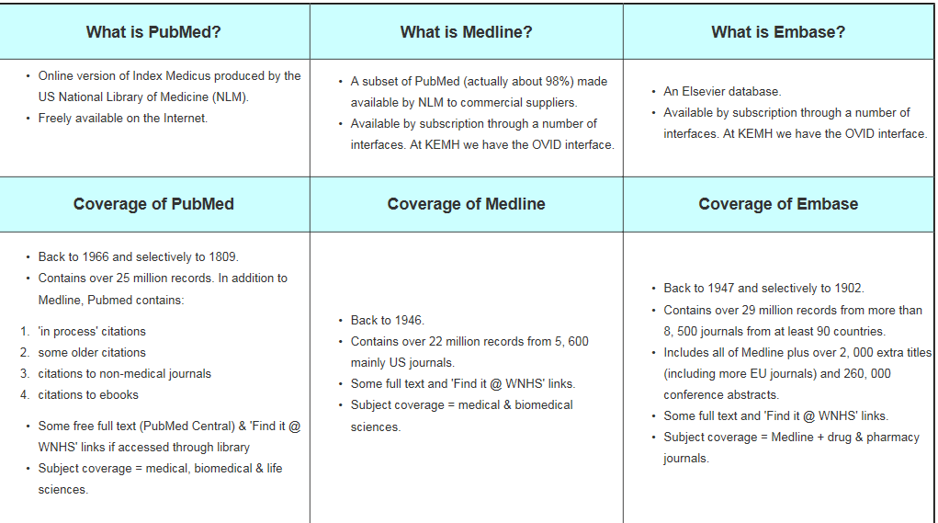
Databases

Slide 14
Interface/search engines
PubMed
search in Medline (primarily)
Ovid
search in Medline, Embase, Cochrane, etc.
-> slightly different results by searching in the
Medline database via these interfaces ->
more papers via PubMed

Slide 15

PubMed
PubMed covers
Medline articles + PubMedCentral papers
a. articles “ahead of print”
b. articles “in process”- prior to being indexed with MeSH term
c. full text articles deposited to promote open access

Slide 16
PubMed
MeSH
(Medical Subject Headings) is the NLM controlled vocabulary thesaurus used for indexing articles for PubMed
Free text
keywords

Slide 17
Flow
Chart
Identify potentially relevant citations
from searching electronic databases and
hand searching of other appropriate sources
(n = #)
Exclude irrelevant citations
after screening all titles and
abstracts
(n = #)
Retrieve hard copies of all potentially relevant citations
identified through the above searches + contact with experts,
going through reference lists and other sources
(n = #)
Exclude irrelevant studies
after detailed assessment
of full text
(n = #)
Include studies in systematic review
(n = #)
For accurate Flow Diagrams see: Preferred Reporting Items for Systematic Reviews and
Meta-Analyses (PRISMA) (PRISMA (prisma-statement.org))

Slide 18
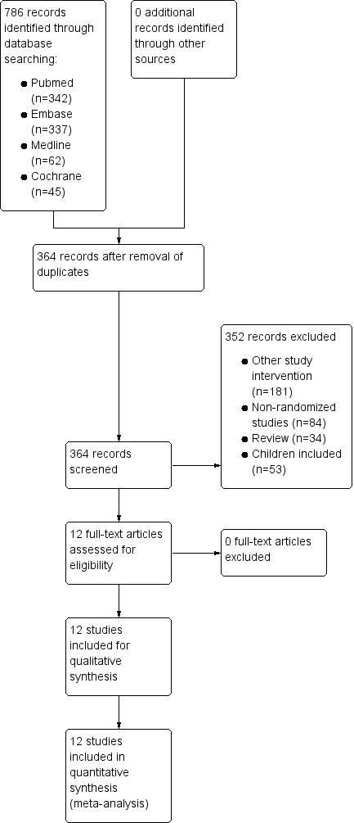

Design review
3. Selection of studies according
to in- and exclusion criteria
≥ 2 reviewers independently
Preferably no language restriction
Criteria: content (PICOT), type of study, etc.

Slide 19
Design review
4. Assessment of the methodological quality
of the studies
≥ 2 reviewers independently of each other
Validated checklists (specific checklists depending on the design of the included studies)

Slide 20
Tools to assess quality
RCT’s
Cochrane Risk of Bias tool voor RCT’s
RoB 2: A revised Cochrane risk-of-bias tool for randomized trials
(RoB 2: A revised Cochrane risk-of-bias tool for randomized trials | Cochrane Bias)
Non-randomized studies
ROBINS-I tool (ROBINS-I | Cochrane Bias)
Diagnostic studies
QUADAS-2 tool for quality assessment of diagnostic accuracy studies
(QUADAS | Bristol Medical School: Population Health Sciences | University of Bristol)

Slide 21
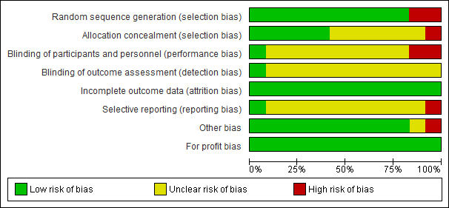
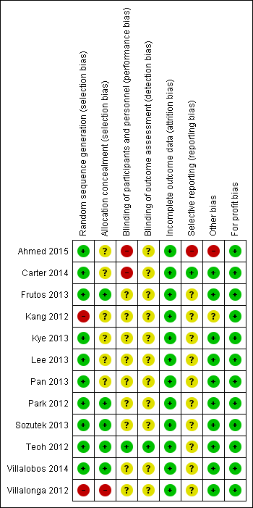
Cochrane Collaboration’s tool for assessing risk of bias

Slide 22
Design review
5. Data extraction and presentation of results
≥ 2 reviewers independently of each other
Template (e.g. in Excel) → all important data
Per study per outcome a point estimate of the effect → RR, OR, mean difference (+ 95%CI)

Slide 23
Design review
6. Pooling results (meta-analysis)
Check if pooling possible
Choice of a statistical model
(depending on the presence of heterogeneity)
Subgroup analysis, if applicable
(planned in advance)

Slide 24

Design review
7. Sensitivity analysis
E.g. leaving out studies with low methodological quality
→ impact on the results?

Slide 25

Design review
8. Conclusion
The answer to the research question, supported by results
Done!

Slide 26
Meta-Analysis
Quantitative synthesis
Pooling

Slide 27
Terms
?
Heterogeneity
Fixed effect model
?
?
Funnel plot
Publication bias
Forest plot
?
?
?
Pooling
Random effects model

Slide 28
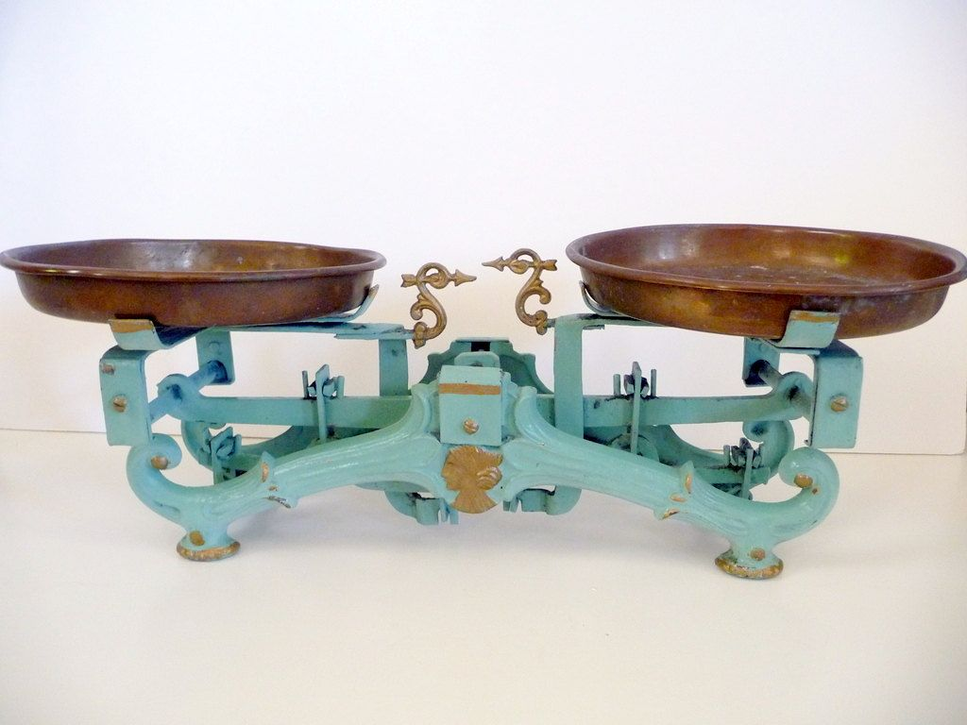
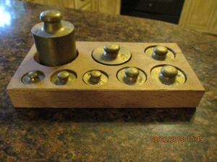
Pooling
When studies look alike/comparable→ results can be combined in one estimate → weighted average
Weight depends on → size of each study
→ participants with an ‘event’
Hoe hij meeweegt
m
Resultaatatting (95% BI smaller)

Slide 29
Pooling
When studies look alike/comparable→ results can be combined in one estimate → weighted average
Weight depends on → size of each study
→ participants with an ‘event’
Hoe
hij meeweegt
m
Resultaat → prett (95% BI smaller)
big/a lot of
more weight

Slide 30

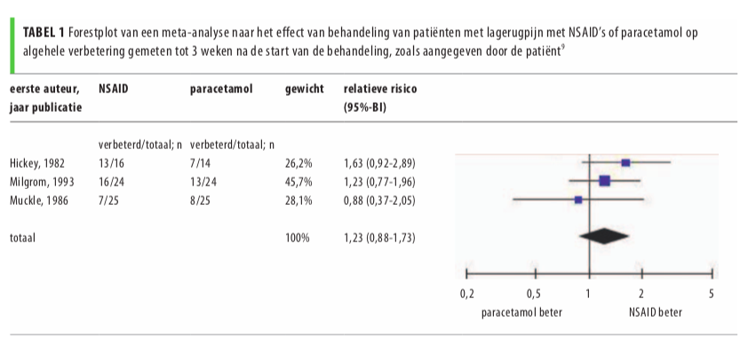
Graphical display meta-analysis
Forest plot
Meta-analysis of the effect of treatment of patients with lower back pain with NSAID’s or Paracetamol on the overall improvement in
3 weeks after the start of treatment, as reported by the patient
First author,
publication year
NSAID
Paracetamol
Weight
Relative risk
(95% CI)
improved/total
improved/total
Total
Favours Paracetamol
Favours NSAID
Meta-analyse: principes en valkuilen; Wim Opstelten en Rob J.P.M. Scholten

Slide 31
Graphical display meta-analysis
Forest plot
Meta-analysis of the effect of treatment of patients with lower back pain with NSAID’s or Paracetamol on the overall improvement in
3 weeks after the start of treatment, as reported by the patient
First author,
publication year
NSAID
Paracetamol
Weight
Relative risk
(95% CI)
improved/total
improved/total
Total
n event weight
30 20 26,2
2) 48 29 45,7
3) 50 15 28,1
Favours Paracetamol
Favours NSAID
Meta-analyse: principes en valkuilen; Wim Opstelten en Rob J.P.M. Scholten

Slide 32
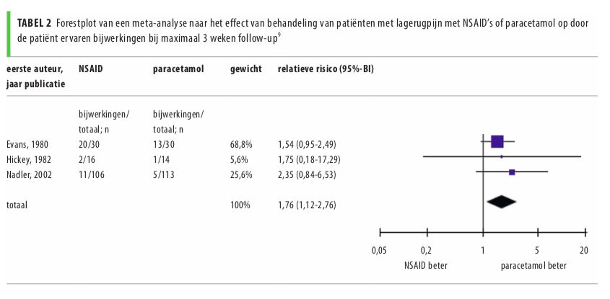
Graphical display meta-analysis
Meta-analysis of the effect of treatment of patients with lower back pain with NSAID’s or Paracetamol on the outcome side-effects up
to 3 weeks after the start of treatment, as reported by the patient
First author,
publication year
NSAID
Paracetamol
Weight
Relative risk
(95% CI)
side-effects/
total
side-effects/
total
Total
Favours Paracetamol
Favours NSAID
Paracetamol better
Meta-analyse: principes en valkuilen; Wim Opstelten en Rob J.P.M. Scholten

Slide 33
Graphical display meta-analysis
Meta-analysis of the effect of treatment of patients with lower back pain with NSAID’s or Paracetamol on the outcome side-effects up
to 3 weeks after the start of treatment, as reported by the patient
First author,
publication year
NSAID
Paracetamol
Weight
Relative risk
(95% CI)
side-effects/
total
side-effects/
total
Total
Favours Paracetamol
Favours NSAID
Paracetamol better
Meta-analyse: principes en valkuilen; Wim Opstelten en Rob J.P.M. Scholten
The power of meta-analysis

Slide 34
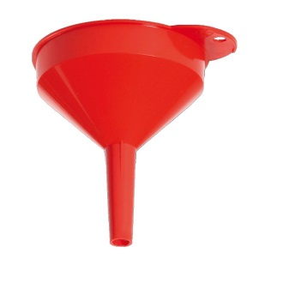
Publication bias?
funnel
If studies with negative results are missing → overestimation of the effect
Funnel plot: all identified studies → plotting the effect against the precision of the estimation
Meta-analyse: principes en valkuilen; Wim Opstelten en Rob J.P.M. Scholten

Slide 35
Publication bias?
funnel
If studies with negative results are missing → overestimation of the effect
Funnel plot: all identified studies → plotting the effect against the precision of the estimation
No bias - symmetry

Slide 36
Publication bias?
funnel
If studies with negative results are missing → overestimation of the effect
Funnel plot: all identified studies → plotting the effect against the precision of the estimation
No bias - symmetry
Bias – asymmetry
(small studies with ‘no effect’
are missing)

Slide 37
Publication bias?
funnel
If studies with negative results are missing → overestimation of the effect
Funnel plot: all identified studies → plotting the effect against the precision of the estimation
No bias - symmetry
Bias – asymmetry
(small studies with ‘no effect’
are missing)
Bias – asymmetry
(also small studies of low
methodological quality can
lead to overestimation)

Slide 38

Pooling
Mmmm……
Is this wise to do?
Do the ingredients go together well?

Slide 39
Heterogeneity
1) Clinical heterogeneity
If PICOT not the same
Patients (same stage of the disease?)
Intervention (reproducible?)
Outcome (units? measured the same way?)
2) Statistical heterogeneity
When the results of the studies differ considerably

Slide 40
Heterogeneity
1) Clinical heterogeneity
If PICOT not the same
Patients (same stage of the disease?)
Intervention (reproducible?)
Outcome (units? measured the same way?)
2) Statistical heterogeneity
When the results of the studies differ considerably

Slide 41
Options in case of heterogeneity
No pooling
→ studies are clinically not homogeneous
→ considerable statistical heterogeneity
2. Fixed effect model
→ low statistical heterogeneity
3. Random effects model
→ mediocre statistical heterogeneity

Slide 42

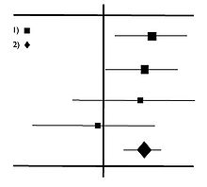
Statistical heterogeneity
Check
‘Eye-ball’ test → look at the Forestplot
→ effect estimates about the same?
→ overlap in 95% CI’s?
I² – statistic = % of variation across studies that is due to heterogeneity rather than chance
< 30% - low heterogeneity
> 60% - considerable heterogeneity

Slide 43
Pooling
Fixed effect model
→ assumption: true effect is the same in all included studies
all factors which could influence the effect size are the
same in all the study populations => variations are only due
to a random error
→ narrow CI’s, high precision of estimates
Random effects model
→ assumption: true effect could vary from study to study
populations differ from each other in ways that could have impact on the treatment effect => 2 reasons for variations – random error + true variation in effect size between the studies
→ broader CI’s, lower precision of estimates

Slide 44

Clinical heterogeneity
If studies not homogeneous → do not pool → misleading results
Option → clinically homogeneous subgroups → subgroup analysis

Slide 45
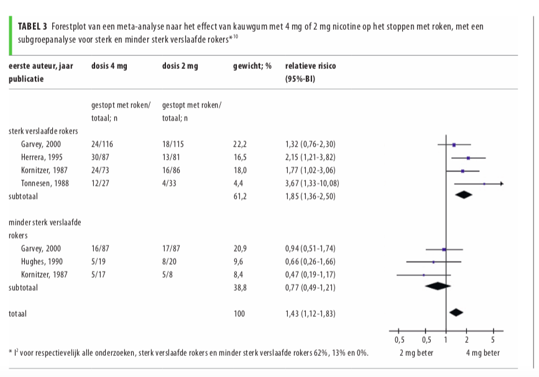
Subgroup analysis
Meta-analysis of the effect of chewing gum containing either 4 mg or 2 mg of nicotine on quitting smoking, with a subgroup
analysis for strongly addicted and less addicted smokers
First author,
publication year
Dose 4 mg
Dose 2 mg
Weight, %
Relative risk
(95% CI)
Quit smoking/
total; n
Quit smoking/
total; n
Strongly addicted smokers
Subtotal
Less addicted smokers
Subtotal
Total
Meta-analysis of the effect of chewing gum containing either 4 mg or 2 mg of nicotine on
Favours 2 mg
Favours 4 mg
Meta-analyse: principes en valkuilen; Wim Opstelten en Rob J.P.M. Scholten
I² = all 62%, strongly addicted 13%, less addicted 0%

Slide 46
Judgment of a review
Explicit clinical question
Steps, according to a protocol
Methodological quality of the studies - adequate?
Results clearly presented (results per study given)
Meta-analysis (pooling justified?, used models, sensitivity analysis)
Can the clinical question be answered, based on the evidence given in the review?

Slide 47
Judgment of a review
Explicit clinical question
Steps, according to a protocol
Methodological quality of the studies - adequate?
Results clearly presented (results per study given)
Meta-analysis (pooling justified?, used models, sensitivity analysis)
Can the clinical question be answered, based on the evidence given in the review?
-----------------------------------------------------------------------------------------------------------------
Checklist: Amstar - A MeaSurement Tool to Assess systematic Reviews
(AMSTAR - Assessing the Methodological Quality of Systematic Reviews)

Slide 48
Strength of evidence
Grade - framework for evaluating the effectiveness of systematic reviews
(Grading quality of evidence and strength of recommendations)
Evidence:
high (RCT’s)
low (observational)
grading down - risk of bias in individual studies, inconsistency of results between studies, indirectness of evidence, imprecision, publication bias
grading up – large magnitude of effect, dose-response gradient and “All
plausible confounding would reduce the demonstrated effect or increase
the effect if no effect was observed”
GRADE handbook (gradepro.org)

Slide 49
Strength of evidence
Grade
Quality of Evidence Grades
Grade | Definition
High | We are very confident that the true effect lies close to that of the estimate of the effect.
Moderate | We are moderately confident in the effect estimate: The true effect is likely to be close to the estimate of the effect, but there is a possibility that it is substantially different
Low | Our confidence in the effect estimate is limited: The true effect may be substantially different from the estimate of the effect.
Very Low | We have very little confidence in the effect estimate: The true effect is likely to be substantially different from the estimate of effect
GRADE handbook (gradepro.org)

Slide 50
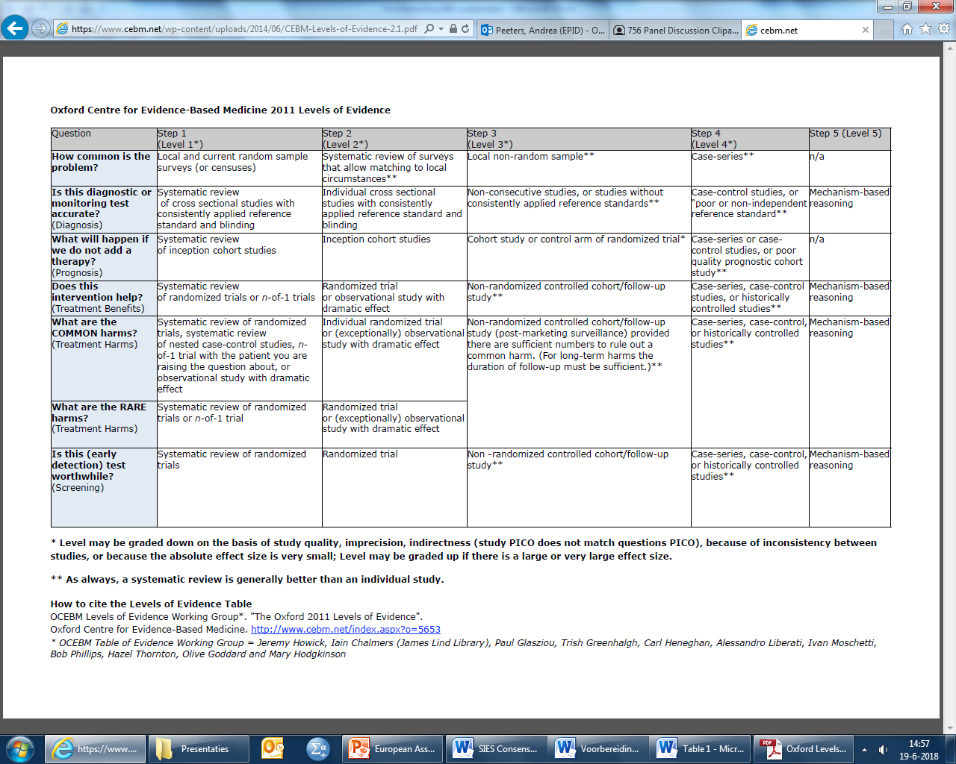
Level of evidence

Slide 51
Level of evidence

Slide 52
The end!

Slide 53
KEMTA Masterclasses
KEMTA website
https://www.mumc.nl/research/kemta/masterclasses
Om je in te schrijven, voor meer informatie, of met suggesties/verzoeken voor onderwerpen kun je contact opnemen met Irene Vrancken (irene.vrancken@mumc.nl)

